Slide 1
Provost Report
Faculty Senate Meeting
Thursday, October 20, 2016

Slide 2
OUTLINE
Faculty questions/concerns following Chancellor’s visits and other recent venues.
Academic Budget Comparison
Faculty Hiring vs Enrollment Trends
Student-Faculty Ratio Comparisons
Faculty Raise Summary
Faculty Retention Summary
Future Sharing of Information
Strategic Faculty Hires
Questions

Slide 3
ACADEMIC BUDGETS
“Original Budget” from Budget Book is the estimated beginning year budget, typically one-quarter prior to a Fiscal Year.

Slide 4
ACADEMIC EXPENDITURES

Slide 5
ENROLLMENT/FACULTY FTE

Slide 6
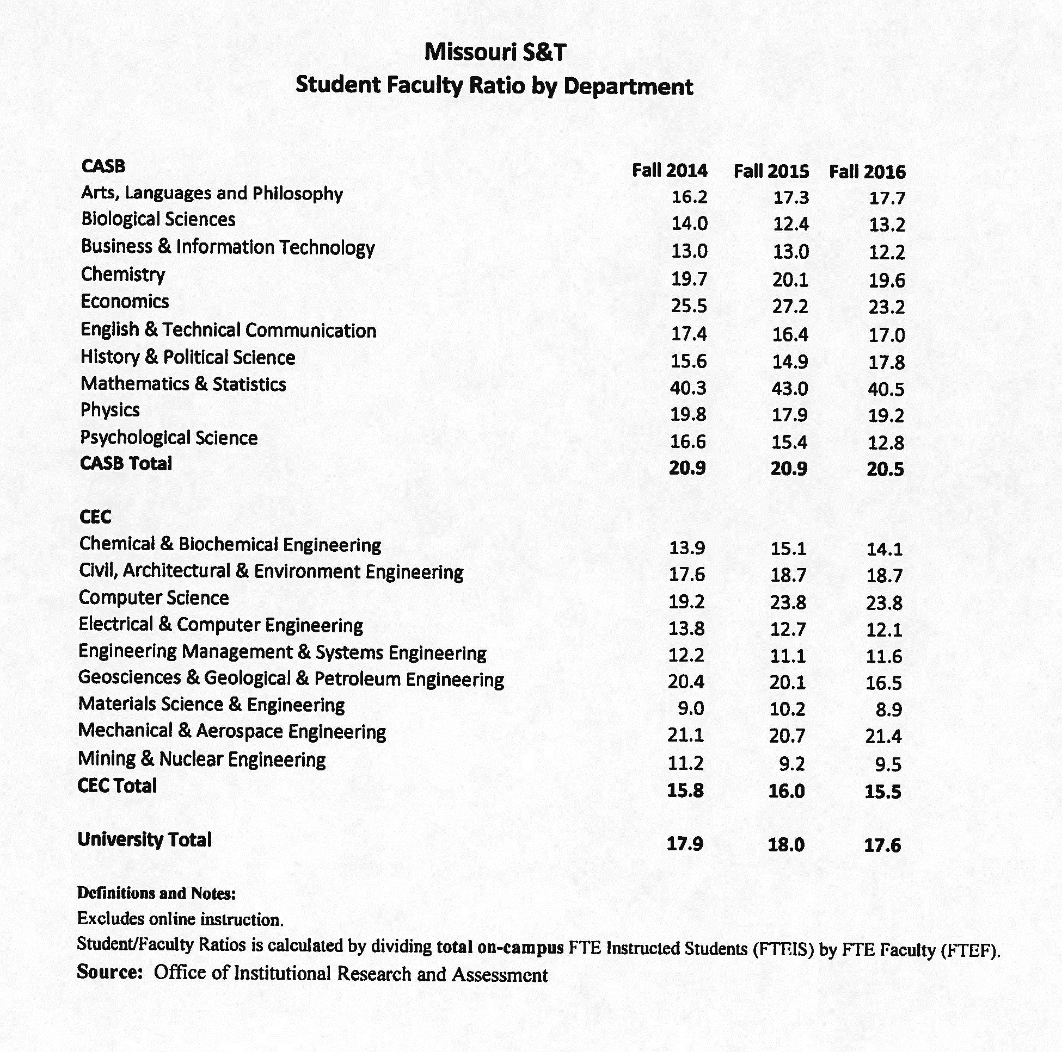
STUDENT/FACULTY RATIO BY DEPT

Slide 7
STUDENT FACULTY RATIO COMPARATORS
INSTITUTION NAME | SFR
California Institute of Technology | 3
Lehigh University | 10
Stevens Institute of Technology | 10
Michigan Technological University | 13
Clemson University | 16
Colorado School of Mines | 16
University of Alabama in Huntsville | 16
Auburn University | 17
New Jersey Institute of Technology | 17
Missouri University of Science and Technology | 17.6
Georgia Institute of Technology-main campus | 18
Kansas State University | 19
University of Missouri-Columbia | 20
Oklahoma State University-main campus | 20
Texas Tech University | 22
University of Wisconsin-main campus | 22
San Diego State University | 28

Slide 8
FACULTY RAISE SUMMARY
Faculty Increase Percentages FY17
Salary Increase Percentages | Number of Faculty
0% | 15 | *
< 0.5% | 7 | 206 | Number of individuals with increases up to the midpoint
0.50% - 0.75% | 28
0.76% - 1.00% | 156
1.01% - 1.25% | 107
1.26% - 1.50% | 23
1.51% - 1.75% | 10
1.76% - 2.00% | 6
2.01% - 3.00% | 9 | 185 | Number of individuals with increases above the midpoint
3.01% - 6.00% | 8
6.01% - 9.00% | 13
9.01% - 12.00% | 1 |  | Upper Administration Raises:
12.01% - 15.00% | 5 |  | Range: 0.00-1.94%
15.01% - 20.25% | 3 |  | Average: 1.08%
Total | 391
*12 received no raise due to retirement/leaving Univ; 1 adequately funded NTT with closed grant; 2 received no raise due to poor performance

Slide 9
FACULTY RETENTION SUMMARY
Retention Issues for FY17
Departments | Salary | Staff Benefits | Total
Chemical & Biological Engineering | (5,000) | (1,769) | (6,769)
Mechanical & Aero Space Engineering | (25,000) | (8,843) | (33,843)
Computer Science | (5,000) | (1,769) | (6,769)
Engineering Management | (21,555) | (7,624) | (29,180)
Dean Office | (6,112) | (2,162) | (8,274)
Materials Science & Engineering | (5,000) | (1,769) | (6,769)
Materials Science & Engineering | (6,600) | (2,334) | (8,934)
Civil, Arch, & Environ Engineering | (6,586) | (2,329) | (8,915)
Sub-Total CEC | (80,853) | (28,599) | (109,453)
Arts, Language and Philosophy | (3,700) | (1,309) | (5,009)
Sub-Total CASB | (3,700) | (1,309) | (5,009)
Total | (84,553) | (29,908) | (114,462)
Retention Offers 11 - 10 Accepted and 1 Declined

Slide 10
FY14 – Strategic hires 2014/2015
Department | Title | Rank
Engineering management and systems engineering | Assistant Professor | T/TT
Physics | Assistant Professor | T/TT
Biological Sciences | Assistant Professor | T/TT
Electrical and computer engineering | Assistant Professor | T/TT
Mining & Nuclear Engineering | Assistant Professor | T/TT
Chemistry | Assistant Professor | T/TT
Civil, architectural and environmental engineering | Assistant Professor | T/TT
Geosciences and geological and petroleum engineering | Assistant Professor | T/TT
Mechanical and aerospace engineering | Assistant Professor | T/TT
Mechanical and aerospace engineering | Assistant Professor | T/TT
Computer science | Assistant Professor | T/TT
Computer science | Assistant Professor | T/TT
Department | Title | Rank
Computer science | Assistant Teaching Professor | NTT
Electrical and computer engineering | Assistant Teaching Professor | NTT
Chemical and biochemical engineering | Associate Teaching Professor | NTT
History and political science- teacher education program | Assistant Teaching Professor | NTT
Materials science and engineering | Assistant Research Professor | NTT
Materials science and engineering | Assistant Research Professor | NTT
Tenured, tenure-track: 12
Non-tenure tack: 6

Slide 11
FY15- Strategic hires 2015/2016
Signature Area | Title | Department | Rank
Advanced Manufacturing | Assistant Professor | Mechanical and aerospace engineering | T/TT
Advanced Manufacturing | Assistant Professor | Electrical and computer engineering | T/TT
Smart Living | Assistant Professor | Psychological science | T/TT
Smart Living | Assistant Professor | Psychological science | T/TT
Smart Living | Assistant Professor | Psychological science | T/TT
Advanced Materials for Sustainable Infrastructure | Assistant Professor | Materials science and engineering | T/TT
Advanced Materials for Sustainable Infrastructure | Assistant Professor | Civil, architectural and environmental engineering | T/TT
Advanced Materials for Sustainable Infrastructure | Assistant Professor | Civil, architectural and environmental engineering | T/TT
Enabling Materials for Extreme Environments | Assistant Professor | Chemistry | T/TT
Enabling Materials for Extreme Environments | Assistant Professor | Physics | T/TT
Enabling Materials for Extreme Environments | Assistant Professor | Mining and nuclear engineering | T/TT
Department | Title | Rank
Psychological science | Assistant Teaching Prof | T/TT
Mechanical and aerospace engineering | Assistant Teaching Prof | NTT
Tenured, tenure-track: 11
Non-tenure track: 2

Slide 12
FY16- Strategic hires 2016/2017
Department | Title | Rank
Mining and nuclear engineering | Associate Professor | T/TT
Mathematics and statistics | Assistant Professor | T/TT
Mathematics and statistics | Assistant Professor | T/TT
English and technical communication | Assistant Professor | T/TT
Electrical and computer engineering | Assistant Professor | T/TT
Electrical and computer engineering | Professor | T/TT
Joint Hire (GGPE/MNE) | Assistant Professor | T/TT
Joint Hire (CS/ECE/EMSE) | Assistant Professor | T/TT
Chemical and biochemical engineering | Assistant Teaching Professor | NTT
Biological sciences | Assistant Teaching Professor | NTT
Economics | Assistant Teaching Professor | NTT
Tenured, tenure-track: 8
Non-tenure track: 3
TOTAL
Tenured, tenure-track: 31
Non-tenure track: 11

Slide 13
Future sharing of information:
provost.mst.edu
Questions?

Slide 14
Division Updates
Faculty Senate Meeting
Thursday, October 20, 2016

Slide 15
Enrollment Management
Thank you to everyone that contributed to the Open House on October 8. We had 152 families compared to 154 last year.
Tim Albers will be the Interim Vice Provost and Dean for Enrollment Management.
Special thank you from Laura Stoll – I want to thank all the faculty, especially those in Faculty Senate, that I have worked with the past 38 years. I admire and respect the efforts that each of you make every day. I wish you all success in your personal endeavors and may you find fulfillment during your time at Missouri S&T.

Slide 16
College of Arts, Sciences, and Business
Phil Whitefield (Chemistry) has been awarded $579,234 by DOT for his project entitled “Examination of Engine to Engine PM Emissions Variability using an ARP Reference Sampling and Measurement System.”
Gayla Olbricht (Mathematics and Statistics) has been awarded $6,250 by Brigham Young University for her project entitled “MCTP: Center for Undergraduate Research in Mathematics.”
Julia Medvedeva (Physics) has received additional funding in the amount of $37,592 by Northwestern University for her project entitled “CEMRI: Multifunctional Nanoscale Materials Structure” bringing the total award amount to $210,410.
Honglan Shi (Chemistry) has been awarded $68,853 by Tulsa Metropolitan Utility Authority for her project entitled “Harmful Algal Bloom and Cyanotoxin Control in City of Tulsa Drinking Water Treatment Plants.”

Slide 17
College of Engineering and Computing
Formula SAE Race Team ranked 2nd in the US and 9th in the World.
ArcelorMittal monetary contribution to S&T.
Dr. Matt O’Keefe, (MSE) patented issued with Surender Maddela (now at GM Tech Center)
S&T earned the Faculty-Mile award for attendance at the ASEE Midwest Section annual meeting.
Dr. Christi Patton Luks, (ChBE) received the Outstanding Service Award for outstanding service to engineering and technology education and her involvement in ASEE and ASEE Midwest Section activities.
Dr. Amardeep Kaur, (ECE) elected chair-elect of the ASEE Midwest Section.
Dr. John Myers, (CArEE) named to the Editorial Board of the Journal Sustainability in Engineering and Science.
Dr. Genda Chen, (CArEE) interviewed by The Economist, a notable international news magazine about his research on bridge scour and his “smart rocks”

Slide 18
Office of Undergraduate Studies
Fellowships, Scholarships & Awards
Our office is coordinating and assisting with nominations and applications for national and international scholarships and fellowships.
Experiential Learning Awards & Service Learning Awards
Faculty and Staff Awards
Nominations Due November 18th
Curators’ Teaching Summit
The 2nd session of the annual Curators’ Teaching Summit was October 13th
43 participants, Topic was “Practical Tips to Help Students Succeed in Your Class”
Service Learning Symposium and Civic Engagement Fair
The service learning symposium in conjunction with the civic engagement fair was successful with over 80 participants.

Slide 19
Office of Graduate Studies:
New Chancellor’s Distinguished Fellowship
For domestic doctoral students
Nominated by department
$10,000 fellowship annually (ON TOP of 50% FTE and tuition/supplemental fees included with that appointment)
Remittance of dedicated fees (IT, activities, health center fees)
4 years for students with a Master’s, 5 years for students with a bachelor’s
Application process will open in Nov. for students who will begin a doctoral program in 2017
New GRA/GTA/GA Funding
Any PhD student on a 37.5% FTE GRA/GTA/GA appointment or higher AND any MS student in a non-PhD granting department on a 37.5% FTE GRA/GTA/GA appointment or higher appointment will receive:
Remittance of tuition
Remittance of supplemental fees

Slide 20
Office of Graduate Studies
Three Minute Thesis (3MT)
Preliminary and Semi-Final Rounds held 10/5
Final Round held 10/6
30 students participated
6 finalists:
Joshua Heck (Mech. Eng., MS) – 1st Place
Michelle Gegel (Mech. Eng., PhD) – 2nd Place
Jatin Mehta (Chemistry, PhD) – People’s Choice
Lizzette Perez-Lespier (Eng. Mng., PhD)
Keerthana Pamidimukkala (Elec. Eng., MS)
Zuhair Al-Jaberi (Civil Eng., PhD)

Slide 21
Office of Sponsored Programs
Summary of FY17 activities year-to-date (July)
Number of funded proposals is down 26% for a total of 20
Total dollars is $2M which is down by 42%
Number of new proposals submitted is up 34% for a total of 39
Total dollars is $15M which is up by 37%
Number of active awards is up by 11% at 627
Total expenditures is $3.3M which is down by 5%
Net grant and contract expenditures is $3M which is down by 7%
F&A recovered is $701K which is down by1%

Slide 22
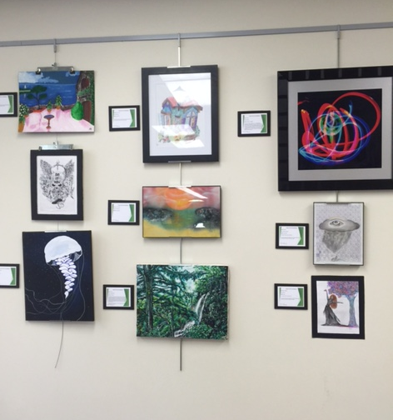
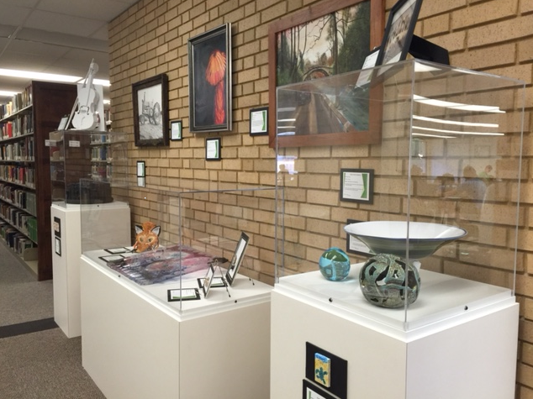
Curtis Laws Wilson Library
Student Art Exhibit, Opening 10/17/2016. Prizes and exhibit sponsored by the Library and CASB. Please visit, Library, 2nd floor.
Art in the Library Committee: Roger Weaver (facilitator), Tracy Primich, Sherry Mahnken, Nancy Krost, Meg Brady, Luce Myers

